Slide 1
Connecting Research and Researchers
Emerging Industry Standards: A Primer
Ed Pentz
Executive Director, CrossRef
epentz@crossref.org
http://orcid.org/0000-0002-5993-8592

Slide 2
What is the problem?
The research community has lacked the ability to link researchers and scholars with their professional activities.
Name ambiguity
Discoverability within and across databases
Author, grantee, and faculty record management
Output tracking
Research reporting and impact assessment
Notes:
Name ambiguity is a fundamental issue we need to address and solve. Ambiguity may be the result of a common name, by a person with several language variants of their name, or by variations in how name information is collected. But, even after addressing name ambiguity, to support discoverability, we need to connect information across databases, disciplines, organizations, and nations. A persistent name identifier addresses both challenges.

Slide 3
Why use ORCID?
An illustrative example: Jens Åge Smærup Sørensen
J. Å. S. Sørensen
J. Aa. S. Sørensen
J. Å. S. Sorensen
J. Aa. S. Sorensen
J. Å. S. Soerensen
J. Aa. S. Soerensen
Jens Å. S. Sørensen
Jens Aa. S. Sørensen
Jens Å. S. Sorensen
Jens Aa. S. Sorensen
Jens Å. S. Soerensen
Jens Aa. S. Soerensen
J. Åge S. Sørensen
J. Aage S. Sørensen
J. Åge S. Sorensen
J. Aage S. Sorensen
J. Åge S. Soerensen
J. Aage S. Soerensen
Jens Åge S. Sørensen
Jens Aage S. Sørensen
Jens Åge S. Sorensen
Jens Aage S. Sorensen
Jens Åge S. Soerensen
Jens Aage S. Soerensen
J. Åge Smærup Sørensen
J. Aage Smaerup Sørensen
J. Åge Smarup Sorensen
J. Aage Smarup Sorensen
J. Åge Smaerup Soerensen
J. Aage Smaerup Soerensen
Jens Åge Smærup Sørensen
Jens Aage Smaerup Sørensen
Jens Åge Smarup Sorensen
Jens Aage Smarup Sorensen
Jens Åge Smærup Soerensen
Jens Aage Smaerup Soerensen
And on and on it goes …

Slide 4

Why use ORCID?
王伟
王薇
王维
王蔚
汪卫
汪玮
汪威
汪巍
Wei Wang
http:dx.doi.org/10.1103/PhysRevLett.99.230001
4

Slide 5
ORCID Mission
ORCID is an independent, open, not-for-profit, international, and community-driven organization
Registry of persistent unique identifiers for researchers
Automating linkages in research workflows
Notes:
The goal of ORCID is to provide a registry of unique and persistent identifiers that transcends organization, discipline, and nation. ORCID is a truly international endeavor. The registry is open: individuals may register, link, import and share information for no fee. But the registry isn’t enough. For ORCID iDs to be adopted they must be used. So the second part of our mission is collaborating with organizations throughout the research community to embed the iDs in research information systems and workflows.
Our core mission is to provide an open registry of persistent unique identifiers for researchers and scholars AND to automate linkages to research works by embedding identifiers in research workflows.
ORCID is an international, interdisciplinary, open, not-for-profit, community-driven organization. We collaborate with researchers and organizations across the research community.
ORCID was incorporated as a non-profit organization in September 2010.

Slide 6
ORCID is a hub
Funders
Professional associations
Publishers
Universities
Repositories
ORCID iD enables system-to-system interoperability by connecting across disciplines, research sectors, and national boundaries.
Notes:
So, it is a persistent iD, why should this matter? Why should researchers and organizations like yourselves take the time not only to get an ID, but to use it and embed it in your organizations workflows? It is a matter of interoperability.

Slide 7
ORCID by the numbers
10/16/12: registry launch
370,000 registry users
90+ member organizations
50 integrations
51 ORCID ambassadors from 22 countries
25 countries >10,000 unique visitors
9 Sloan-funded A&I partners
5 languages
    French, English, Simplified & Traditional Chinese, Spanish
5 import wizards
    Scopus, CrossRef, RID, Europe PMC, ANDS
1 annual public data file (CC0)
5/21/14: Spring Outreach Meeting (Chicago)
Notes:
The goal of ORCID is to provide a registry of unique and persistent identifiers that transcends organization, discipline, and nation. ORCID is a truly international endeavor. The registry is open: individuals may register, link, import and share information for no fee. But the registry isn’t enough. For ORCID iDs to be adopted they must be used. So the second part of our mission is collaborating with organizations throughout the research community to embed the iDs in research information systems and workflows.
ORCID was incorporated as a non-profit organization in September 2010.

Slide 8
Growth since launch
ORCID has issued over 350,000 identifiers since our launch one year ago
Notes:
But progress has been made so far – Researcher Adoption
Through the end of August we have grown significantly since our October 2012 launch. We now have nearly 300,000 ORCID iD holders who have either registered for iDs using our website (represented in green or by the top sections of each bar), or because of directly encouragement from our member organizations (represented by the section labeled Oauth in blue, or the bottom section of each bar.)
---
http://support.orcid.org/knowledgebase/articles/150557-number-of-orcid-ids
ORCID iDs (includes deactivated iDs)
153560
live ORCID iDs
153243
deactivated iDs
317
iDs that have a verified email addresses
93232
iDs that have at least one work
45059
Of those with DOIs, # of works with unique DOIs
679729

Slide 9
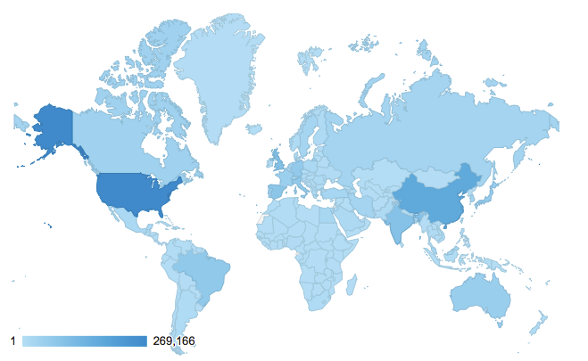
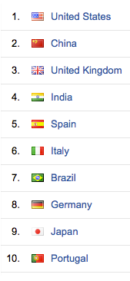
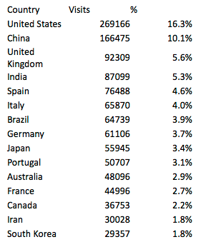

Slide 10
Benefits to the community
Unique and persistent iD can be used throughout career, across professional activities and affiliations
ORCID iD is embedded in works metadata, independent of platform
Improved system interoperability – across discipline, organization, and country
  Reduced reporting workload for researchers
  Automates repository deposition
  Supports institutional reporting
Notes:
So, it is a persistent iD, why should this matter? Why should researchers and organizations like yourselves take the time not only to get an ID, but to use it and embed it in your organizations workflows? It is a matter of interoperability.

Slide 11
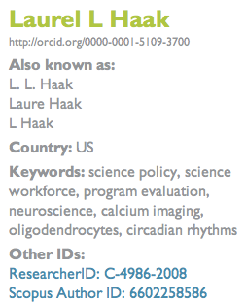
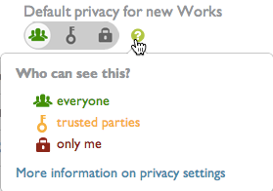
For researchers & scholars
Free & fast for researchers
16-digit number expressed as HTTP URI
Compatible with ISO standard
Record holder controls privacy

Slide 12
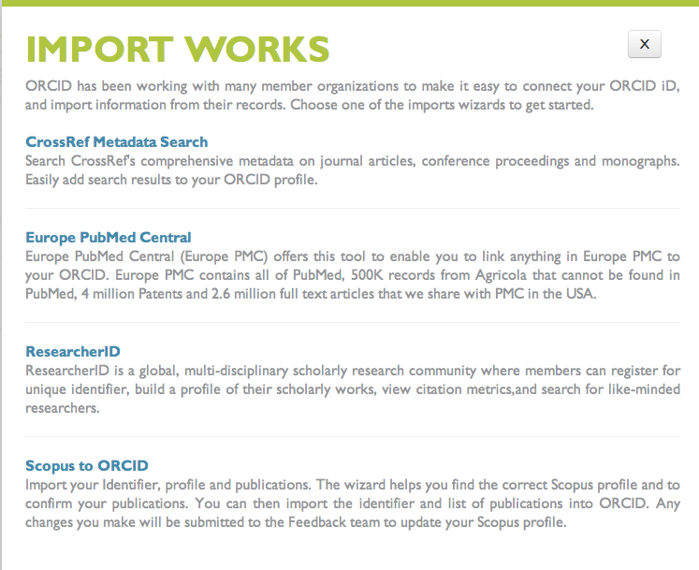
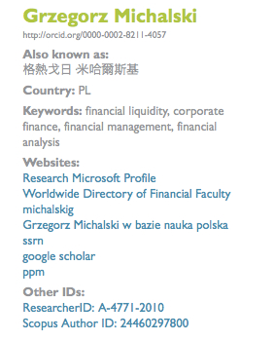
Link to your works & IDs

Slide 13
What can organizations do with ORCID?
ORCID APIs support system-to-system communication and authentication. Through these, organizations can:
  Get a user’s ORCID iD
  Get data from an ORCID record
  Let a user import from your system to their ORCID record
  Enable the user to display on their ORCID record a link to themself on your system
  Create ORCID iDs for employees and associates
http://orcid.org/organizations/integrators
Notes:
Mention that the first two are supported by the Public API, the rest require membership
Anyone can register to test the APIs and integrations on the ORCID sandbox—no membership required.

Slide 14
Adoption & Integration Program
Alfred P. Sloan Foundation grant to promote development of use cases and integrations at North American research universities/institutes and professional societies
Nine program partners, receiving grants of up to $20,000,
Grantees will demonstrate prototypes at May 21, 2014 Outreach Meeting (Chicago)
Code and resources shared, to support broad adoption & integration

Slide 15
Adoption & Integration Program
Repositories
  U Missouri—Dspace/MOspace (w/ @mire)
  Notre Dame—Hydra Plug-in
  Purdue—HUBzero
  Reactome—integration into international biological pathways knowledge center
Professional Societies
  SfN—membership management
Researcher Information Systems
  Boston University—Profiles
  Cornell—VIVO
Multi-facet integrations
  Texas A&M—Vireo ETD workflow
  U Colorado—FIS

Slide 16
More use cases. . .

Slide 17
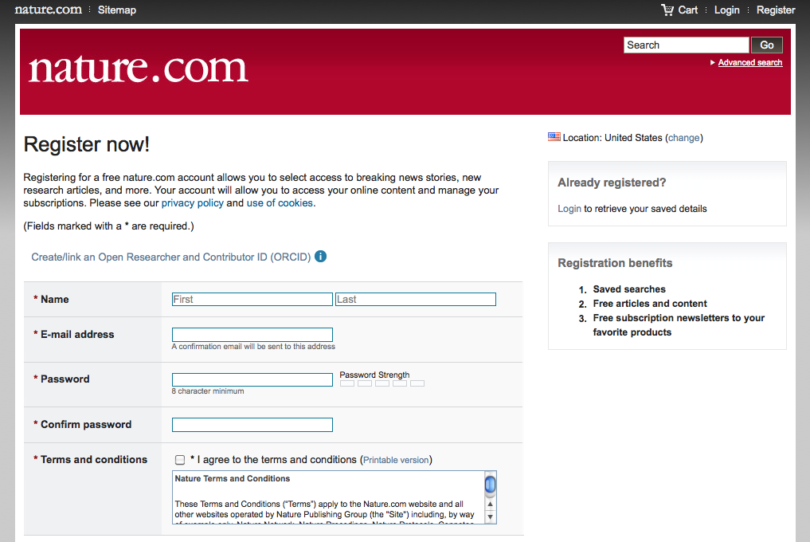
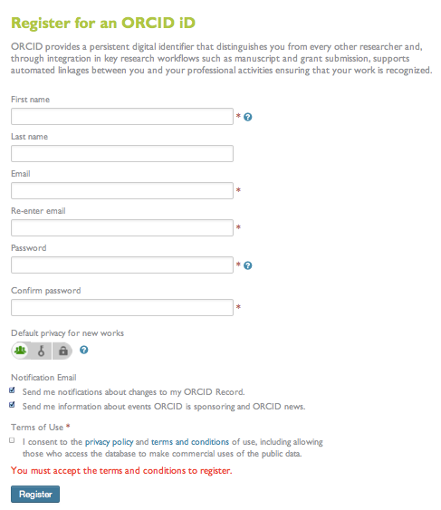
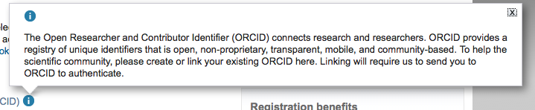
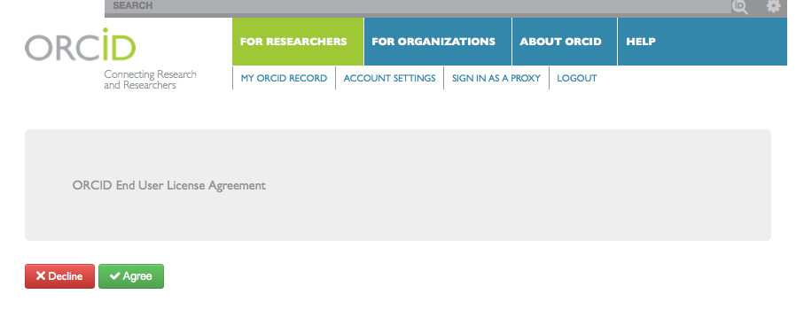
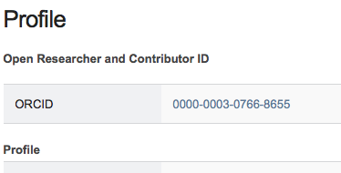
1. Click on ORCID link on Nature.com
2. Redirected to register on ORCID
3. User authorizes data transfer
4. ORCID iD is stored in Nature database
Manuscript submission workflow
2
1
3
4

Slide 18
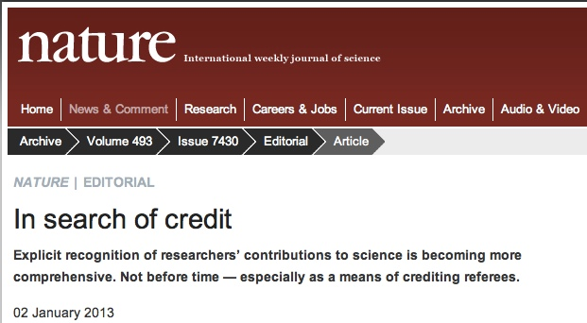
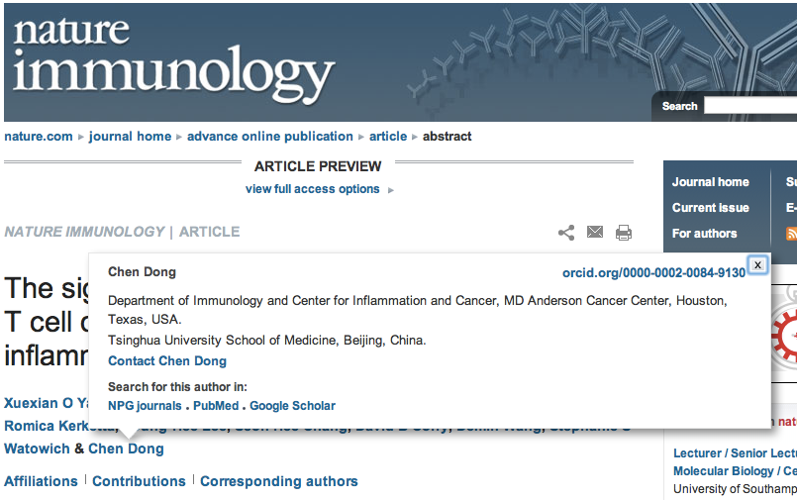
Publication process
“Nature journals authors can link their ORCID to their account in our manuscript submission and tracking system, and we[are now] publishing authors’ ORCIDs in papers.”
ORCID iDs are being received by CrossRef and PubMed
Diehl LA, Souza RM, Alves JB, Gordan PA, Esteves RZ, Jorge ML, Coelho IC. InsuOnline, a Serious Game to Teach Insulin Therapy to Primary Care Physicians: Design of the Game and a Randomized Controlled Trial for Educational Validation. JMIR Res Protoc. 2013 Jan 21;2(1):e5. doi: 10.2196/resprot.2431. PubMed PMID: 23612462, AUID- ORCID: 0000-0002-9958-7213
Notes:
Now have two publishers that have implemented end-to-end integration of ORCID identifiers, Hindawi and Nature. The first ORCID iDs were submitted with manusciupt metadata to CrossRef in March and to PubMed in April. We’ll see a demo od the Hindawi process today.

Slide 19
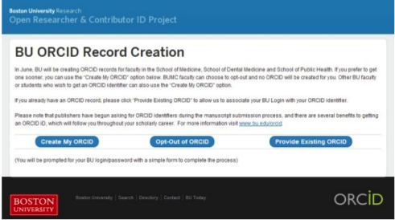
Record creation
BU has created ORCID iDs for faculty and facilitating the population of the ORCID record with BU profiles information

Slide 20
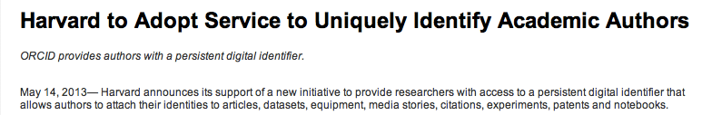
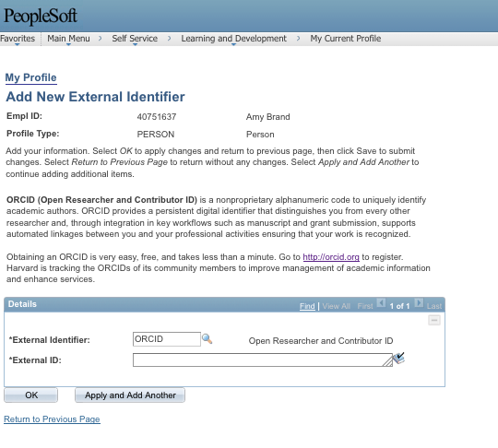
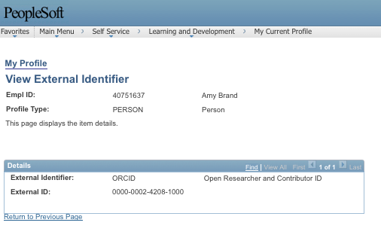
HR system integration
http://library.harvard.edu/harvard-adopt-service-uniquely-identify-academic-authors
System will provide ORCID-HUID pairs for use in Harvard applications, such as DASH open access repository
Add ORCID iD to university HR system
Notes:
Avedas and Symplectic are ORCID service providers, supporting ORCID identifier integration into university profile systems,
ADD HARVARD

Slide 21
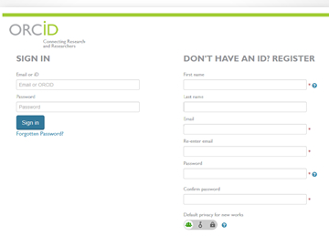
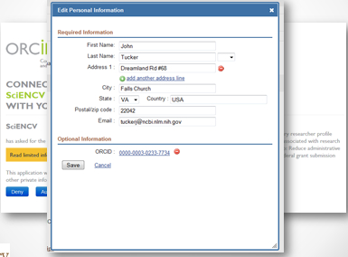
Grant applications
The U.S. National Institutes of Health (NIH) SciENcv includes ORCID iDs
Link grant application to ORCID identifier
Import information from ORCID record
Notes:
NIH is piloting ORCID identifiers in its ScienCV system. The public, beta version will be released in late summer 2013.

Slide 22
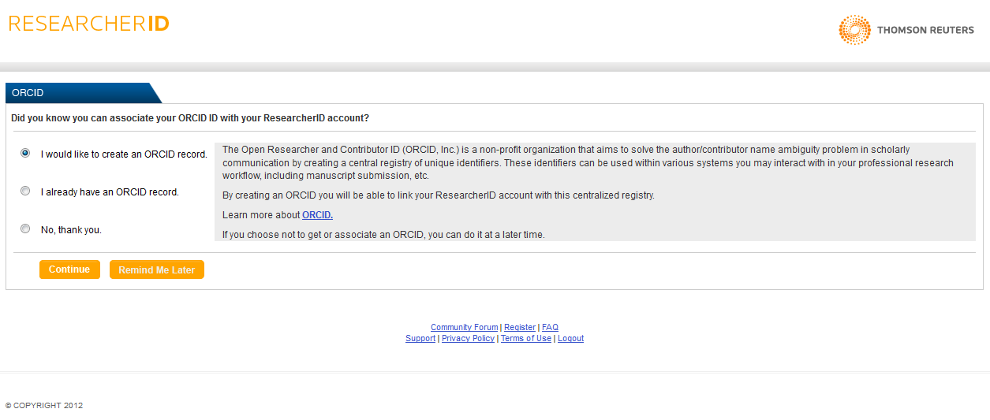
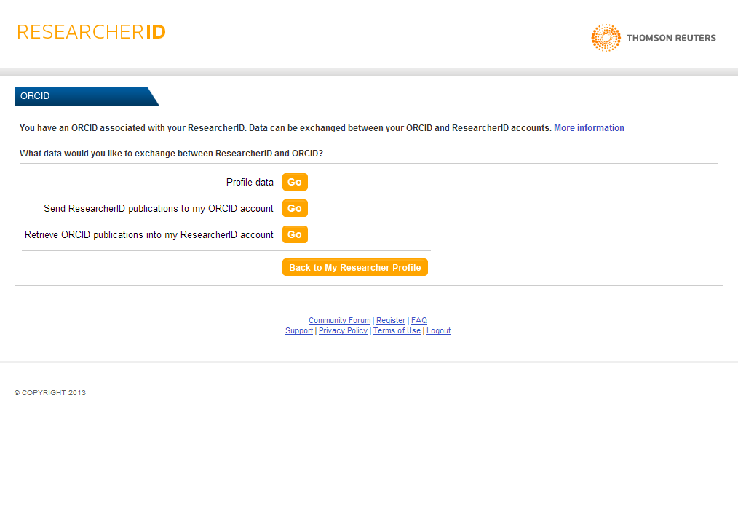
External IDs
Create an ORCID iD or associate existing ORCID iD with ResearcherID
Exchange profile and/or publication data between ORCID and ResearcherID

Slide 23
What’s next?
Users will be able to associate current & past affiliations with their ORCID record (Q4)
Grants & account delegation (Q1)
Triple the registry to 1.5 million users in 2014
Build membership & support adoption: support national memberships, reduce barriers to using authentication, document use cases
Add third-party assertions functionality
Support adoption: Increase international reach: more languages, ambassadors, & community partners

Slide 24
What can you do?
Spread the word
Follow us & give feedback
Claim & populate your iD
    Name variants
    Email addresses
    Biography
    Publications
Display your ORCID iD
Nominate an ambassador at community@orcid.org
Become a member
Integrate!
Save the date! May 21, 2014 Outreach Meeting in Chicago
Subscribe to our blog , http://orcid.org/about/news
Follow, tweet, & retweet @ORCID_Org
iDeas forum

Slide 25
Rebecca Bryant, PhD
Director of Community, ORCID
r.bryant@orcid.org
http://orcid.org/0000-0002-2753-3881

